Slide 1


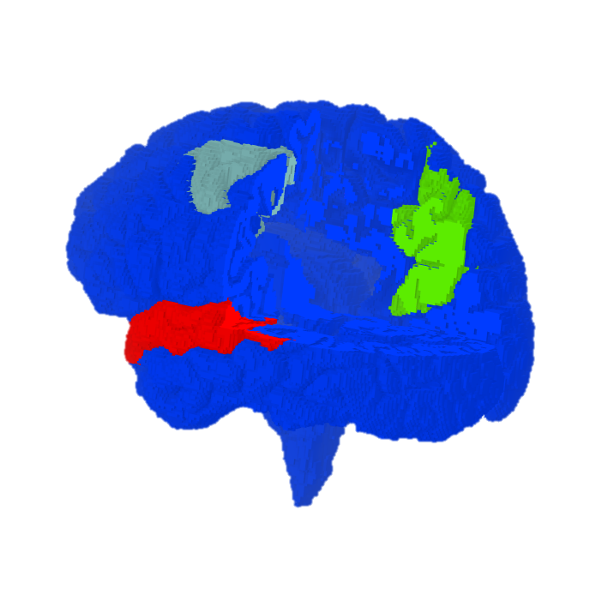
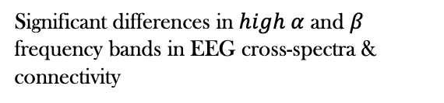
Goal
Significant differences in $high α$ and $β$ frequency bands in EEG cross-spectra & connectivity
Results
Significant differences in the network Global Efficiency in fMRI connectivity
Significant differences in the global standard deviation in fMRI connectivity

